Slide 1
Internet of Things Workshop
Nirma University, PRAVEG 2019

Slide 2

Anmol Tripathi
B.tech, Electrical & Minors in Computer Engg., Nirma University, Have worked with Siemens India on R&D Project. Machine Learning, Internet-of-Things, Deep Learning
Connect @
www.linkedin.com/in/at007 www. github.com/anmol-tripathi

Slide 3
Sensors And Actuators

Slide 4
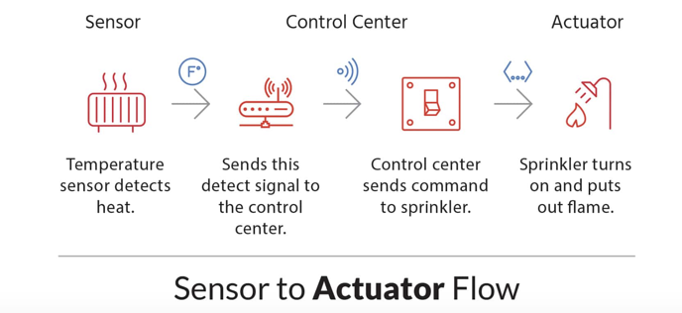

Slide 5
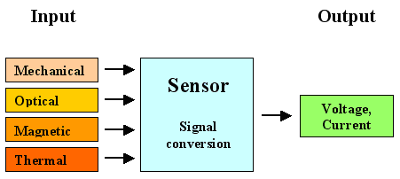

Slide 6
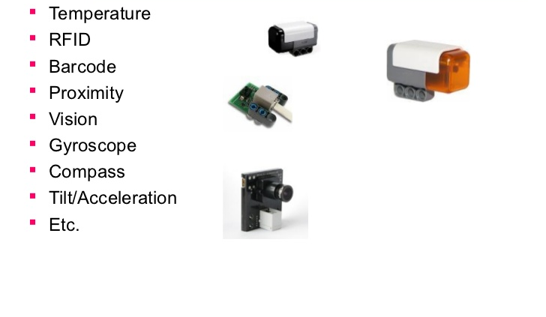

Slide 7
Sensor: any device which converts physical parameter into a signal which can be measured electrically

Slide 8
Sensor: any device which converts physical parameter into a signal which can be measured electrically

Slide 9
Physical Parameters?
Temperature Humidity Blood Pressure Speed

Slide 10
Physical Parameters?
Voltage Acceleration
Distance Level

Slide 11
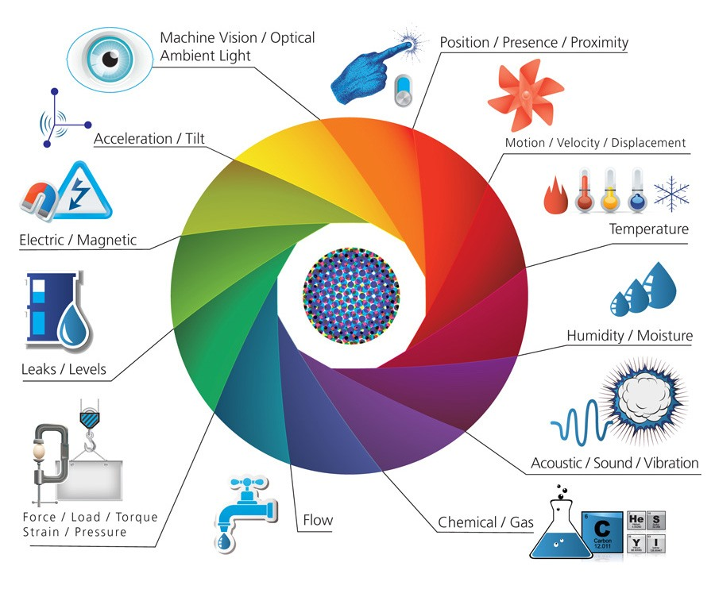

Slide 12
Tell me just five! Which are there on your smartphone!

Slide 13
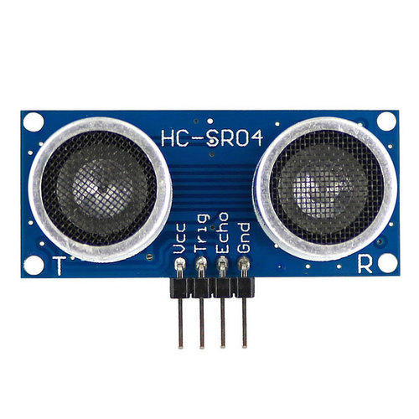
Ultrasonic Sensor

Slide 14
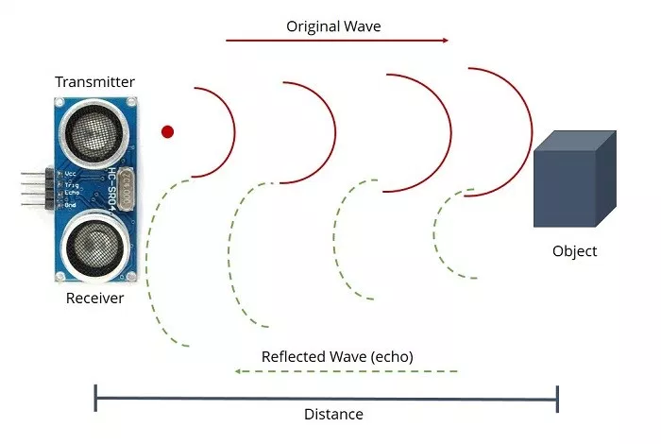

Slide 15
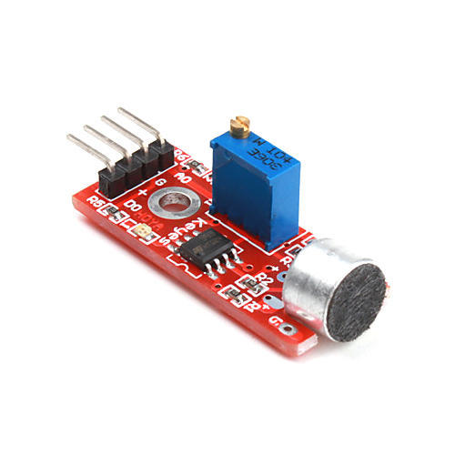
Microphone Sensor

Slide 16
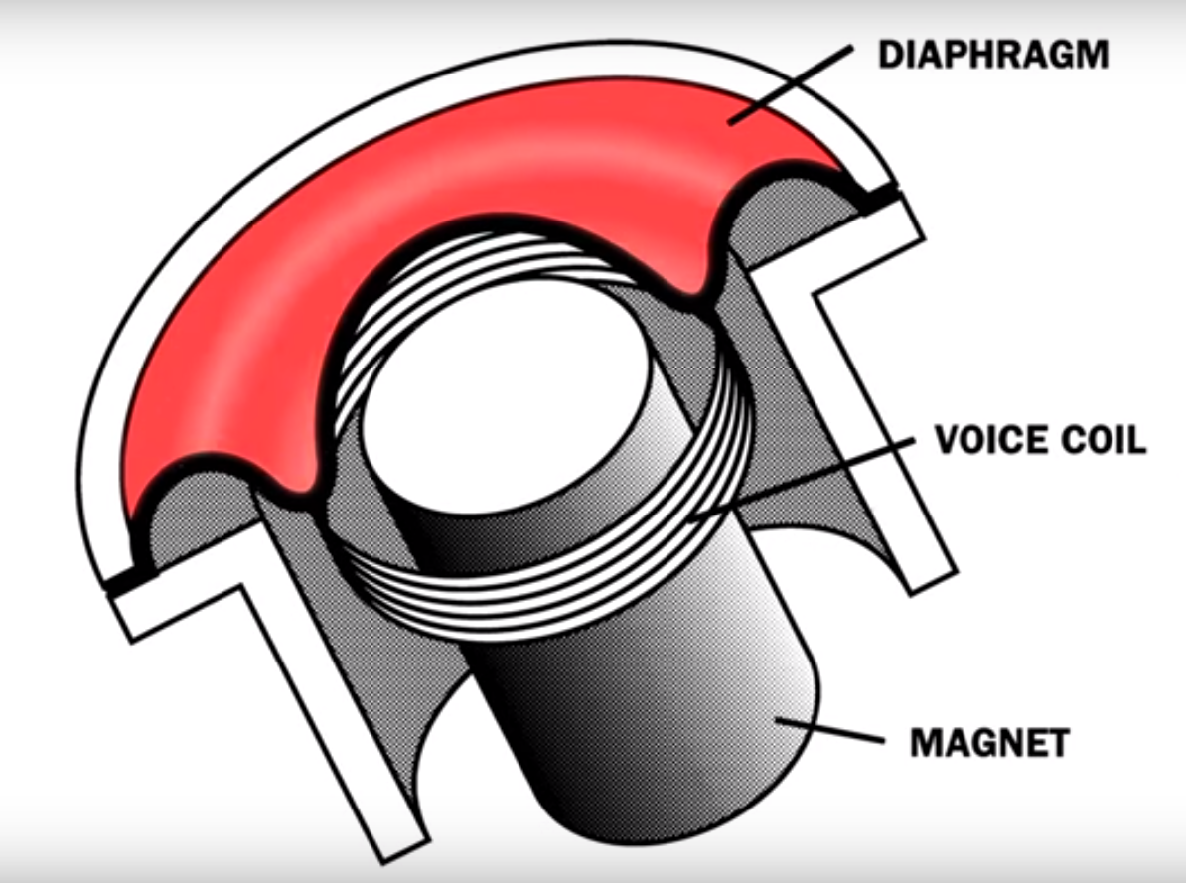

Slide 17
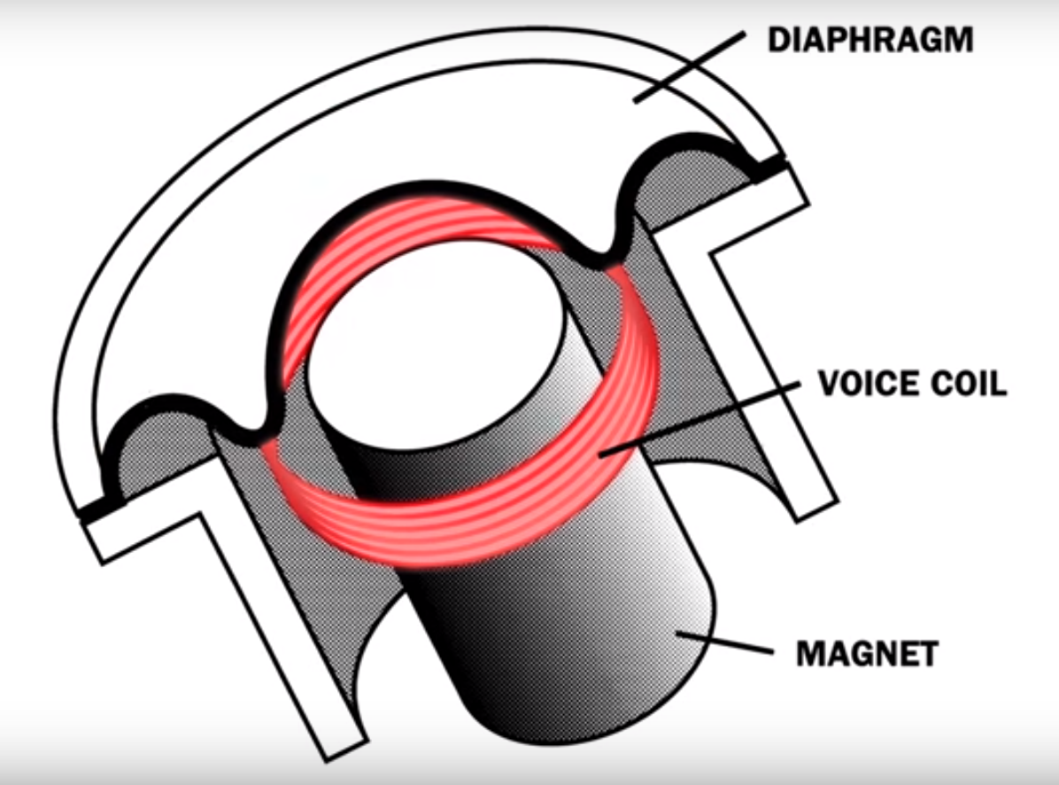

Slide 18
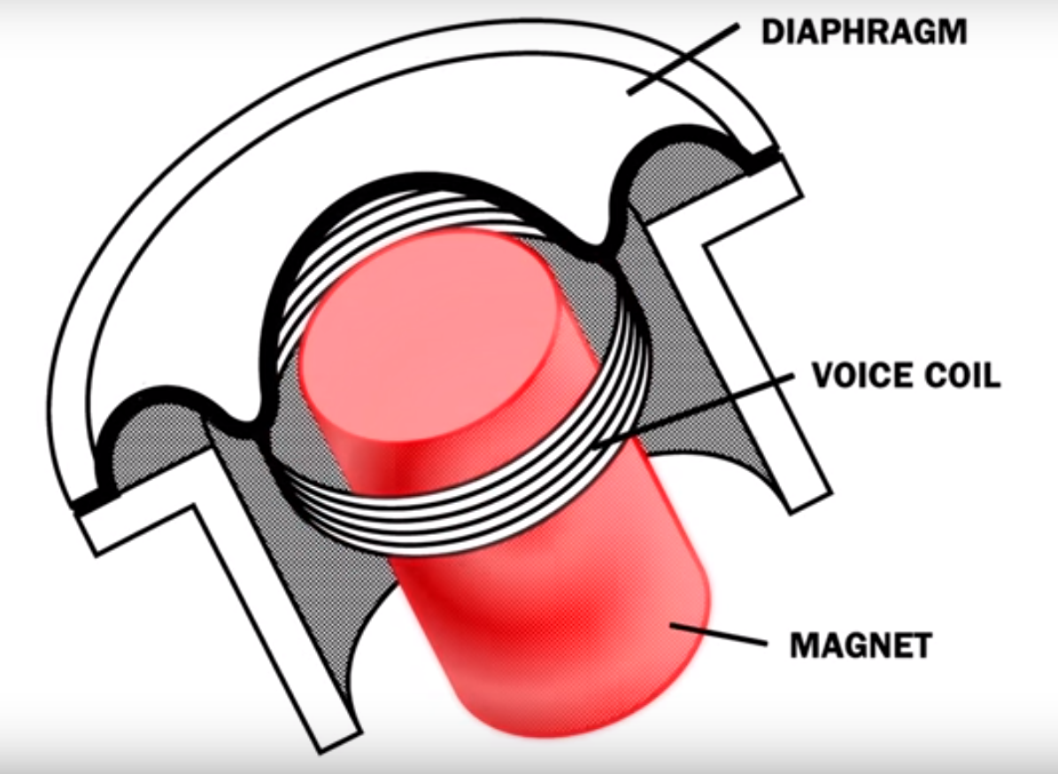

Slide 19
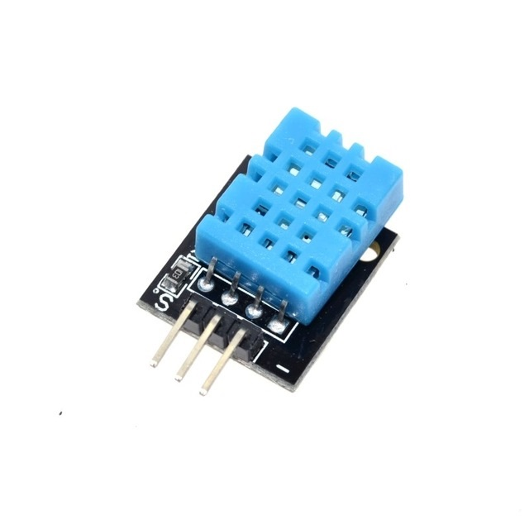
DHT11 Sensor

Slide 20
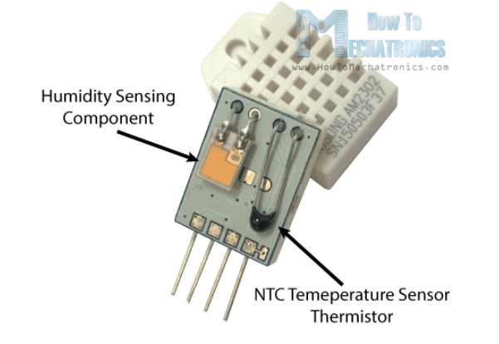

Slide 21
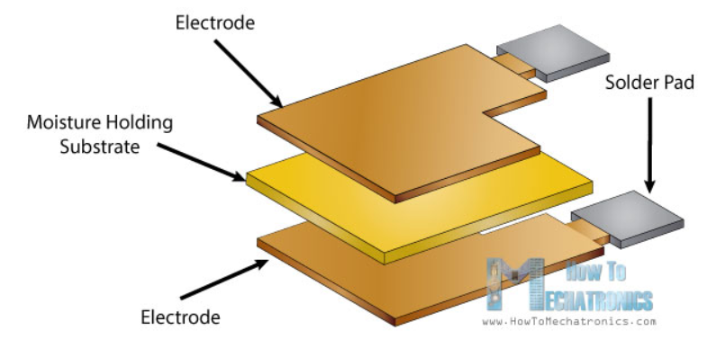

Slide 22
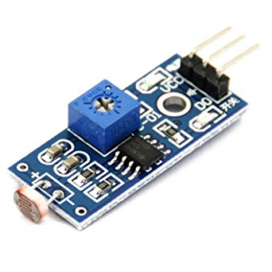
Light Dependent Resistor Sensor

Slide 23
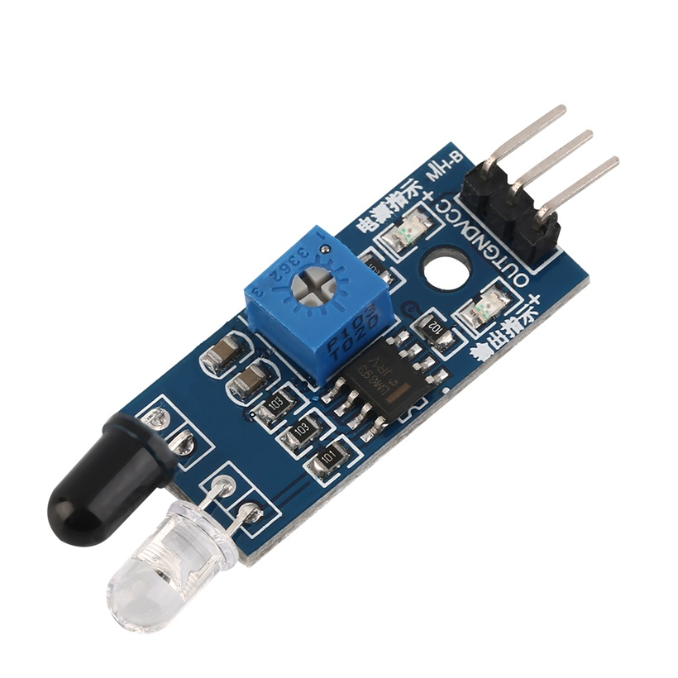
IR Sensor

Slide 24
https://www.thegeekpub.com/wiki/list-of-arduino-sensors-and-modules/

Slide 25
Actuator: is a component of a machine that is responsible for moving and controlling a mechanism. Eg. a valve

Slide 26
Types of Actuators
Hydraulic Pneumatic Electric Mechanical

Slide 27
Types of Actuators
Hydraulic Pneumatic Electric Mechanical

Slide 28
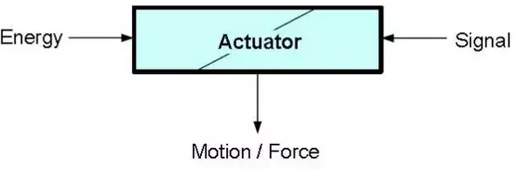

Slide 29
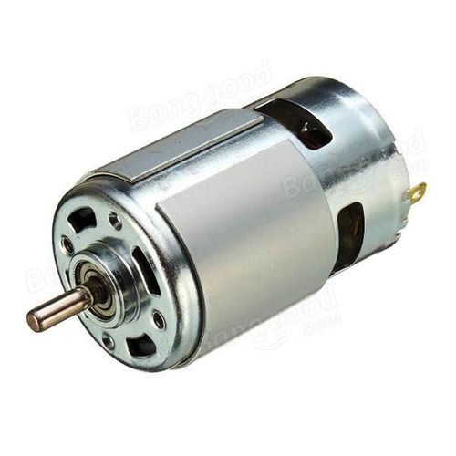
Types of Actuators Motors

Slide 30
Motors
DC Motors
AC Motors
Servo Motors, Stepper motors
Induction Motors

Slide 31
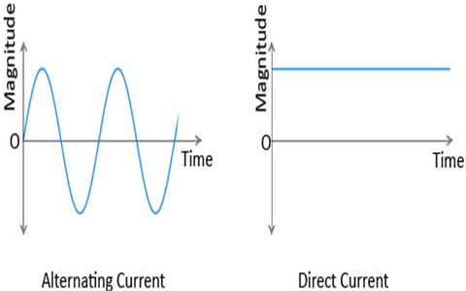
DC vs AC

Slide 32
DC: in which electrons flow in one direction AC: there is change in polarity and direction of electron flow in certain time period

Slide 33
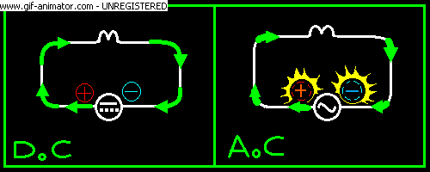

Slide 34


QUIZ TIME
Which of the given wave forms are AC and which are DC?

Slide 35
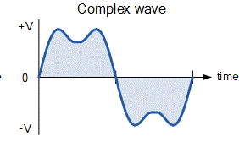

Slide 36
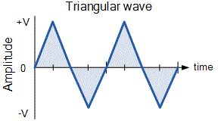

Slide 37
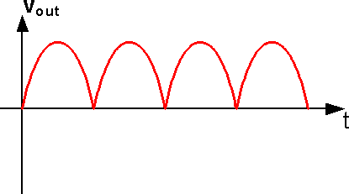

Slide 38
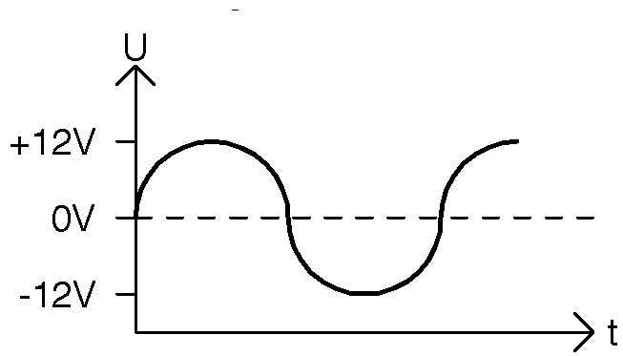

Slide 39
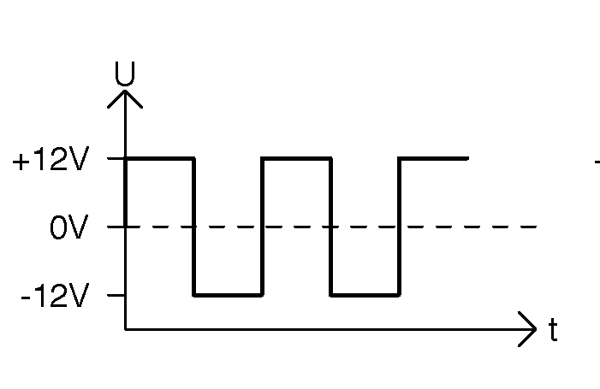

Slide 40
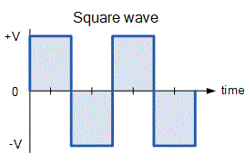

Slide 41
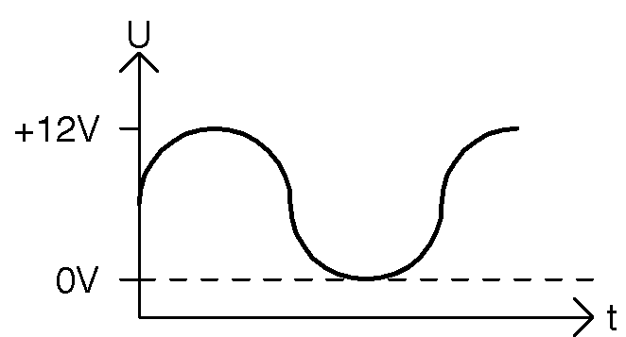

Slide 42
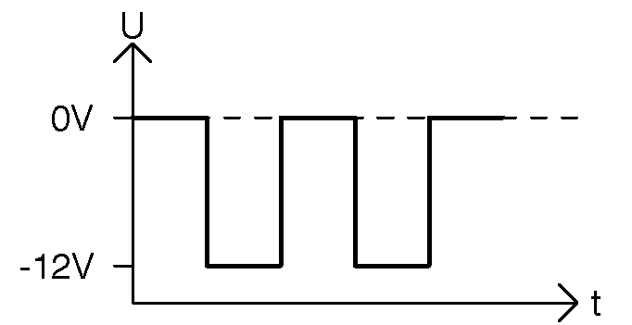

Slide 43
Microcontrollers

Slide 44
Microcontroller vs Microprocessor

Slide 45
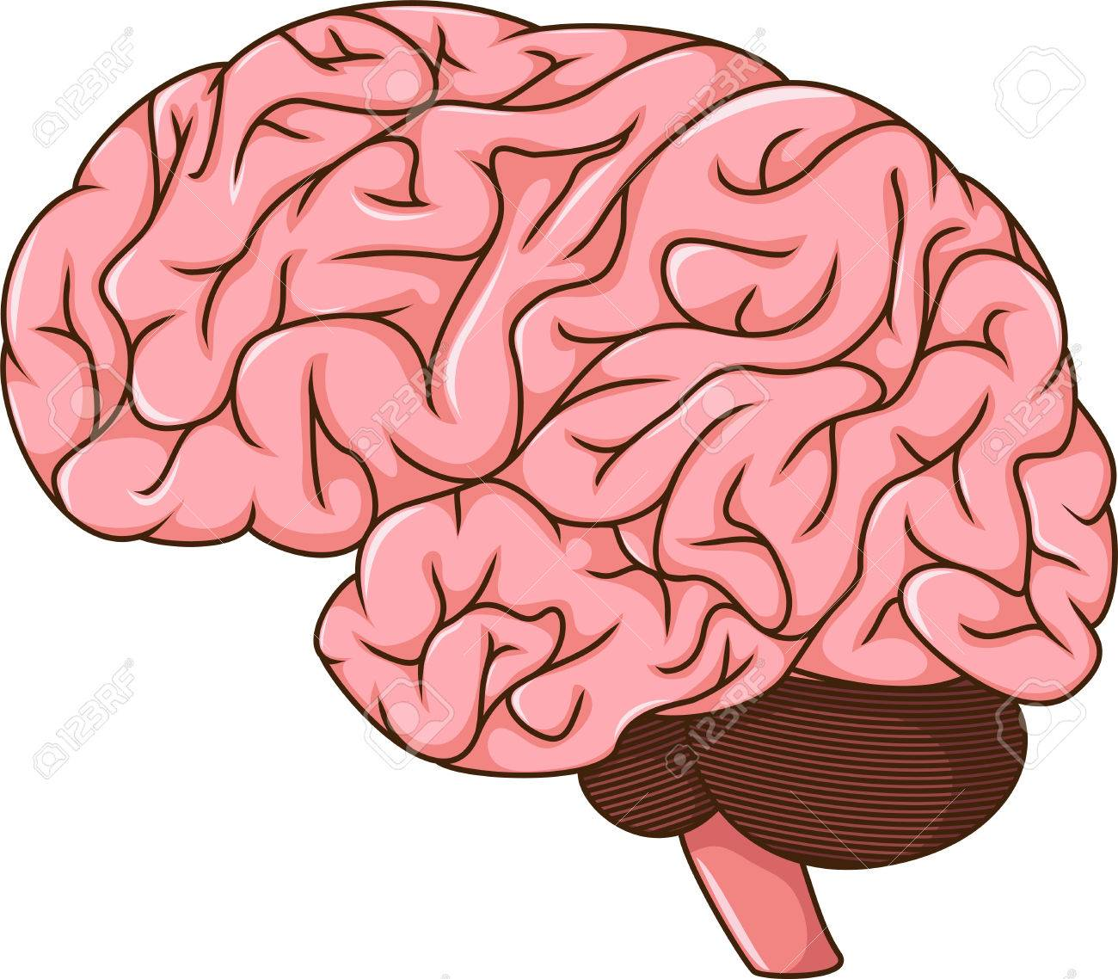
Microprocessor

Slide 46

Microcontroller

Slide 47


Slide 48
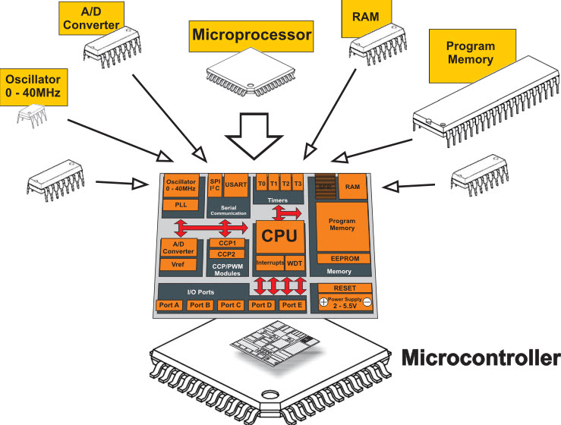

Slide 49
Random access memory (RAM) is a general-purpose memory which usually stores the user data in a program. RAM memory is volatile in the sense that it cannot retain data in the absence of power, i.e. data are lost after the removal of power.

Slide 50
Random access memory (RAM) is a general-purpose memory which usually stores the user data in a program. RAM memory is volatile in the sense that it cannot retain data in the absence of power, i.e. data are lost after the removal of power.

Slide 51
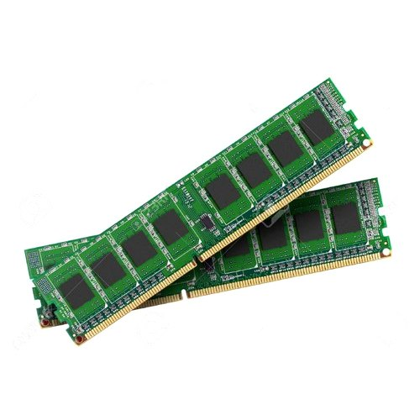

Slide 52
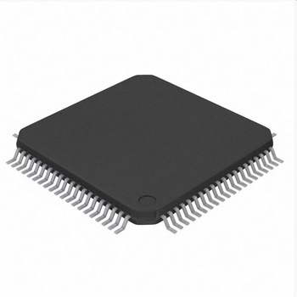

Slide 53
Types of RAM: SRAM DRAM SDR SDRAM DDR SDRAM

Slide 54
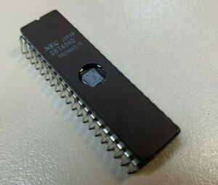

Slide 55
Program Memory: Program memory (program space), is where the microcontroller sketch is stored

Slide 56
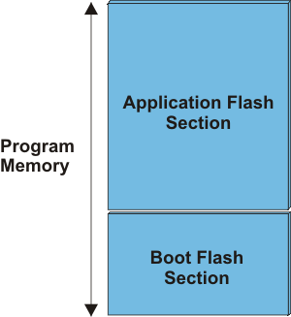

Slide 57
ADC: Analog to Digital Converter is a system that converts an analog signal, such as a sound picked up by a microphone or light entering a digital camera, into a digital signal.

Slide 58
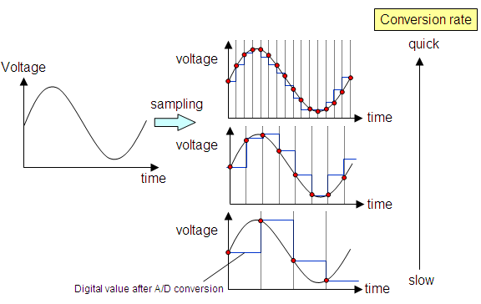

Slide 59
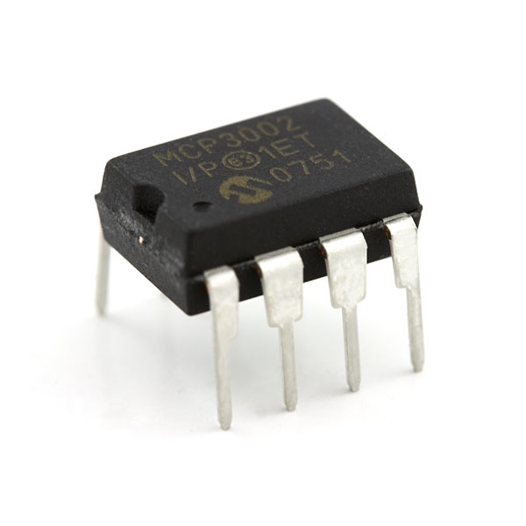
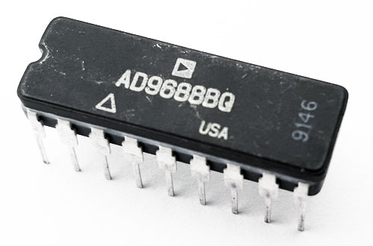

Slide 60
Concept of Leveling

Slide 61
DAC: Digital to Analog Converter is a system that converts a digital signal into an analog signal.

Slide 62
GPIO A general-purpose input/output (GPIO) is an uncommitted digital signal pin on an integrated circuit

Slide 63
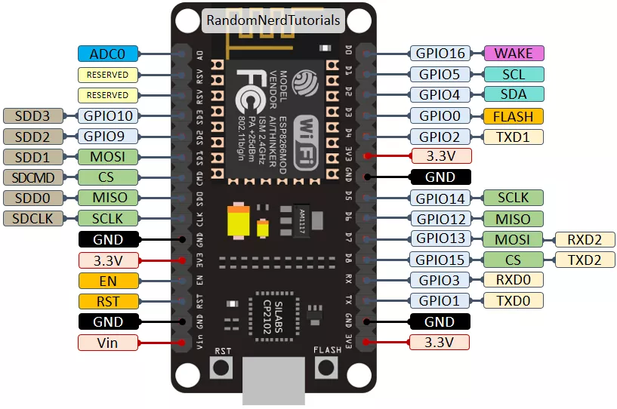

Slide 64
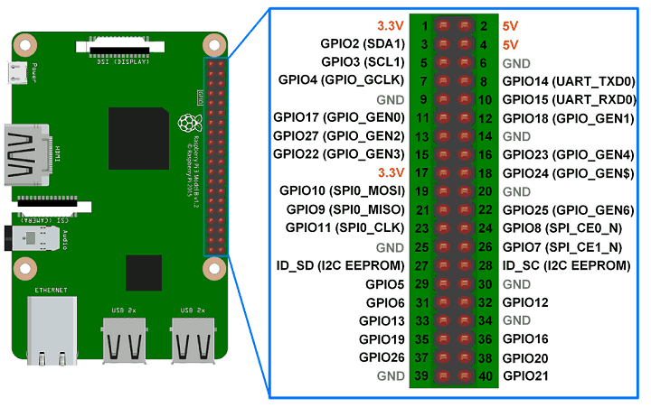

Slide 65
digitalWrite() digitalRead()
analogRead()
analogWrite() {PWM}

Slide 66
Oscillator is a circuit which produces a continuous, repeated, alternating waveform without any input.

Slide 67
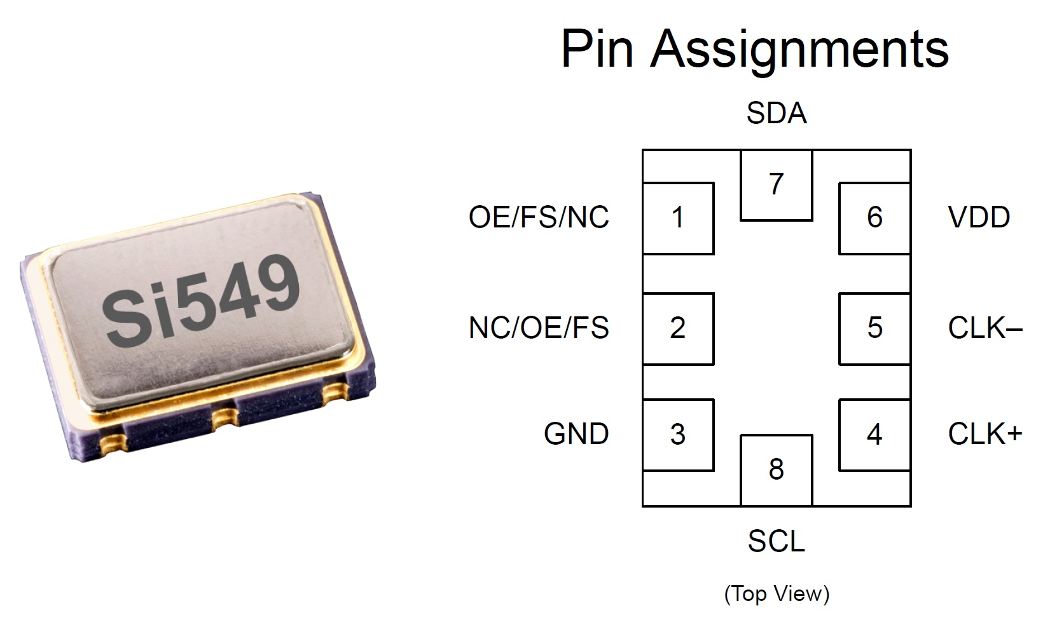

Slide 68
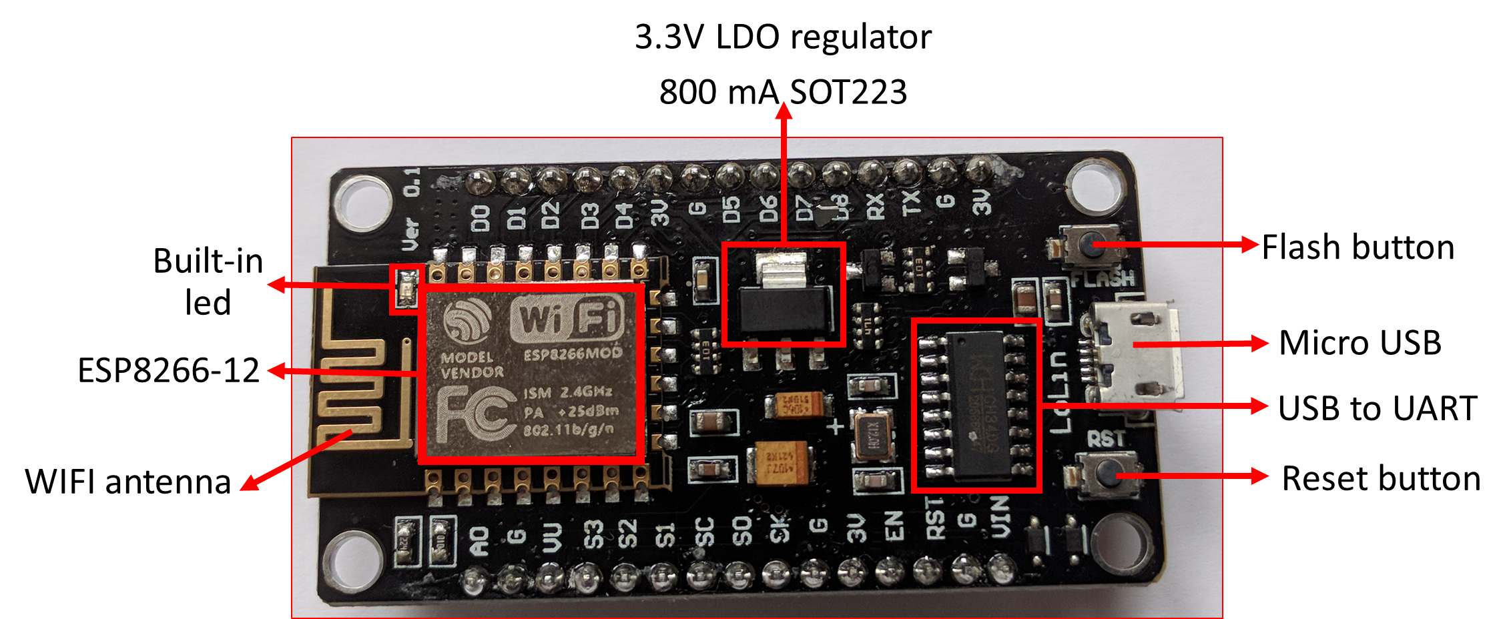

Slide 69
Developer : ESP8266 Opensource Community
Type : Single-board microcontroller
Operating system : XTOS
CPU : ESP8266
Memory : 128kBytes
Storage : 4MBytes
Power By : USB
Power Voltage : 3v ,5v (used with 3.3v Regulator which inbuilt on Board using Pin VIN)
Code : Arduino Cpp
IDE Used : Arduino IDE
GPIO : 10

